Slide 1
Hacker Court 2008
Hack My Face
hackercourt@wkeys.com
Notes:
Title Slide

Slide 2
Cast of Characters
JUDGE: Jonathan Klein
COURT CLERK: Caitlin Klein
BAILIFF: Ryan Bulat
EMCEE/DEFENSE EXPERT: Carole Fennelly – Director, Tenable Network Security
PROSECUTOR: Paul Ohm - Attorney, Associate Professor, University of Colorado School of Law
DEFENSE ATTORNEY: Jennifer Granick,Attorney, Electronic Frontier Foundation
DEFENSE ATTORNEY: Kurt Opsahl– Attorney, Electronic Frontier Foundation
CASE AGENT : Peiter “Mudge” Zatko – Technical Director – National Intelligence Research and Applications, BBN Technologies
REPORTER (Simon Ross of the Guardian): Brian Martin – Tenable Network Security
DEFENDANT (Simple Gnomad) : Weasel - NMRC
Notes:
Cast of Characters

Slide 3
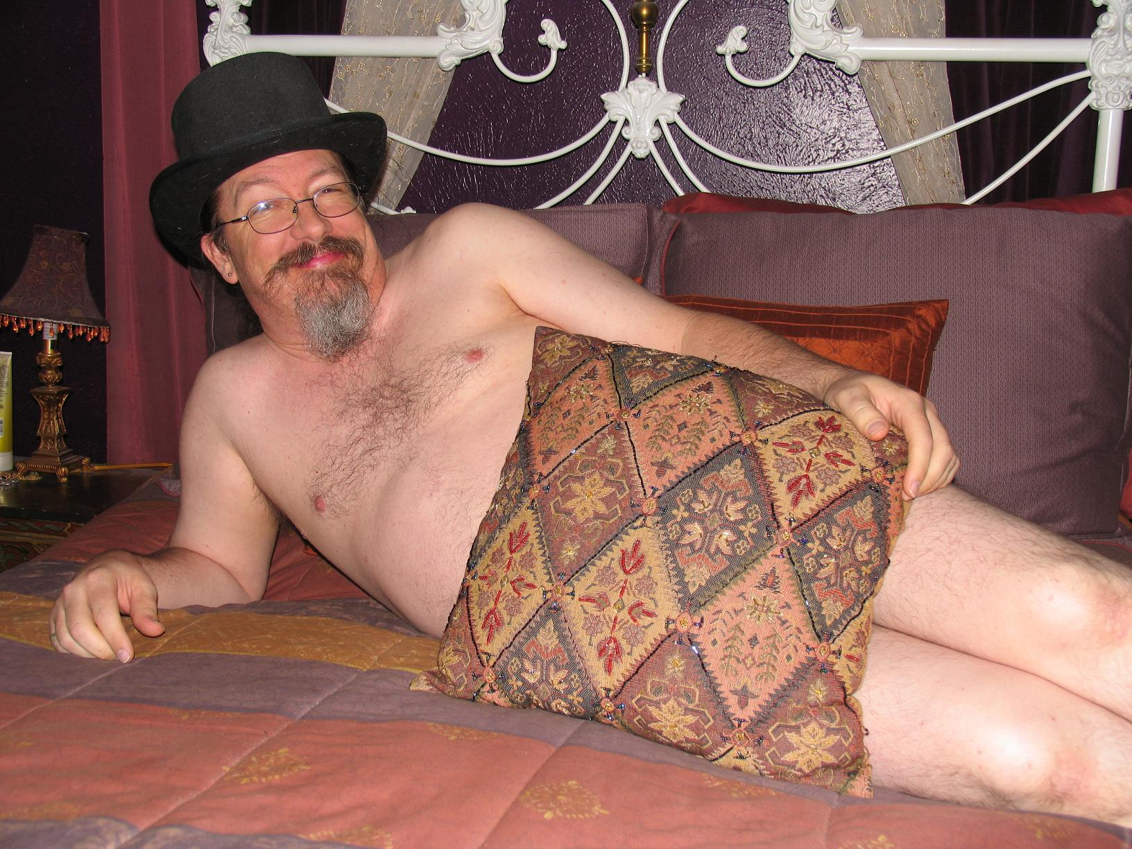
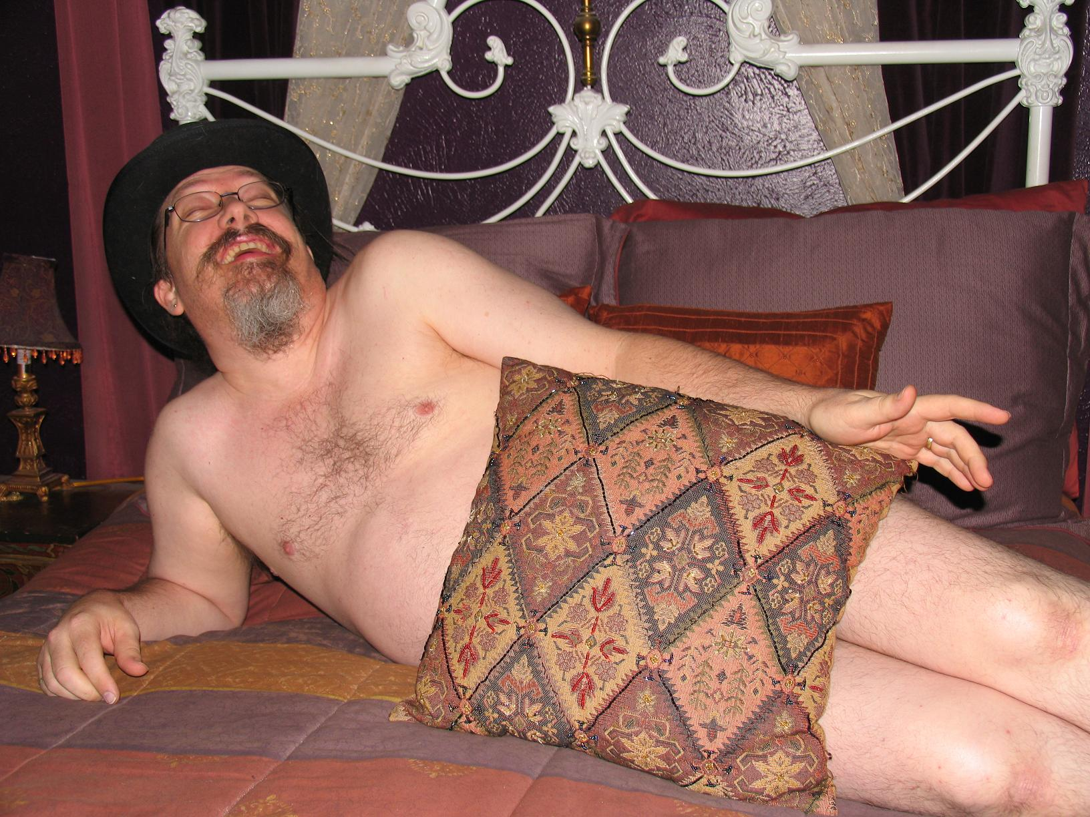
Notes:
Cast of Characters

Slide 4
Schedule
18:15 – Introductions, Court Called to Order
18:20 – 18:50 Opening Statements
18:50 – 19:05 Mudge
19:05 – 19:30 Brian Martin
19:30 – 19:45 Carole Fennelly
19:45 – 20:00 Weasel
20:00 – 20:20 Closing Statements
20:20 – 21:00 Panel Discussion
Notes:
Court Schedule

Slide 5
Witness classification
Factual
Testifies to events directly witnessed or observed. May only testify regarding facts, not draw conclusions.
Expert
Specifically qualified by the court as an expert in the subject at hand. May offer opinion and draw conclusions based on knowledge and expertise.

Slide 6
Prosecution Opening Statement
Attack on the computer
  Zero-Day Exploit
  Deleted Files
  Accessed and Copied Sensitive Data
  Launched Attacks on the network
Consequences
  Secret Service Investigations Compromised
Context
  “No limits”

Slide 7
Defense Opening Statement
This case is about Mudge
Sought out Simple Gnomad and challenged him to hack his machine
Ratted him to the prosecutor
Mudge is testifying against him today placing the blame for his ineptitude on my client
This is Entrapment
This was Authorized
This was no crime

Slide 8
Prosecution Witness 1
Agent Mudge is the Secret Service Case Agent. He is testifying as a factual and expert witness on the break-in of MyFace

Slide 9
Government Exhibit 3
Log from public SILC server, channel #Social:
Jul 22 10:22:21 * mudge (madge@DA1966.8DD6F8.B591A7.FBF431) has joined #Social
Jul 22 10:22:56 <pat>assbyte; yes
Jul 22 10:23:24 <mary>assbyte: so memory is swapped in again
Jul 22 10:23:25 <mudge> hey everyone
Jul 22 10:23:27 <mary> if possible
Jul 22 10:24:13 <assbyte> nice mary
Jul 22 10:24:16 <assbyte> thanks
Jul 22 10:24:19 <mary>np
Jul 22 10:24:29 <engene>mary: didn't know there's this link. interesting. hehe
Jul 22 10:26:31 <mary> http://kernel.org/doc/gorman/html/understand/index.html is the one to bookmark :)
Jul 22 10:26:51 <assbyte> very nice link indeed
Jul 22 10:30:19 * ts has quit (Remote host closed the connection)
Jul 22 10:34:09 <mudge> is s-nomad around?
Jul 22 10:35:00 <bk>mudge: idling
Jul 22 10:35:04 <bk> was on about an hour ago
Jul 22 10:35:25 <bk>mary: that book is 2.4 with 2.6 addendum IIRC
Jul 22 10:35:40 <bk> So some things have changed
Jul 22 10:38:48 <mary> true
Jul 22 10:39:29 * mary would like a decent kernel explanation page/book ;))
Jul 22 10:39:36 <mary> tough still... the basics are still true :)
Jul 22 10:39:38 * assbyte too
Jul 22 10:42:05 * s-nomad is working, not idling
Jul 22 10:42:40 <bk> anything good?

Slide 10
Government Exhibit 3 (cont’d)
Jul 22 10:43:11 <s-nomad>meh, struggling with some odd memory bullshit
Jul 22 10:43:30 <s-nomad> people should be shot for implementing their own alloc
Jul 22 10:43:31 <bk>heh, still? need help?
Jul 22 10:43:43 <s-nomad> yeah getting ready to eat first
Jul 22 10:43:54 <mudge> s-nomad: question for you
Jul 22 10:44:09 <s-nomad> do I know you?
Jul 22 10:44:17 <s-nomad> what is the question?
Jul 22 10:44:35 <mudge> did you comment on a blog recently about an 0day
Jul 22 10:44:42 <s-nomad> I was probably drunk
Jul 22 10:44:50 <bk> 0day?
Jul 22 10:45:09 <s-nomad>bk: don't start...
Jul 22 10:45:19 <bk>heh
SILC private chat:
Jul 22 10:40:04 <mudge> that comment on the ***reporter's name*** blog
Jul 22 10:40:22 <mudge> that 0day you have that allows you to compromise social networking sites
Jul 22 10:40:35 <s-nomad> what?
Jul 22 10:40:45 <mudge> you know
Jul 22 10:40:52 <s-nomad> I *was* drunk
Jul 22 10:40:56 <mudge> you have done 0day stuff before
Jul 22 10:40:58 <mudge> I have a site you can test it on
Jul 22 10:41:04 <s-nomad>jesus
Jul 22 10:41:15 <mudge> seriously
Jul 22 10:41:29 <mudge> it's a piece of cake

Slide 11
Government Exhibit 3 (cont’d)
Jul 22 10:41:49 <s-nomad> it always is
Jul 22 10:42:09 <s-nomad> why would I waste an 0day on you?
Jul 22 10:42:12 <mudge> I don't want the 0day
Jul 22 10:42:28 <mudge> I want you to own the site
Jul 22 10:42:54 <mudge> or can you not do it?
Jul 22 10:43:09 <s-nomad> blow me
Jul 22 10:44:02 <mudge> come on, you are always bragging
Jul 22 10:44:09 <mudge> I want to see if you have the goods
Jul 22 10:44:33 <s-nomad>yoour an asshole
Jul 22 10:44:44 <mudge> yeah
Jul 22 10:44:49 <s-nomad> troll
Jul 22 10:45:04 <mudge> I'd be willing to bet you can't
Jul 22 10:45:17 <mudge> like real money bet you can't
Jul 22 10:47:36 <s-nomad> you'd lose
Jul 22 10:47:48 <s-nomad> big time you'd lose
Jul 22 10:47:58 <mudge> the site is myface, ever hear of it?
Jul 22 10:48:22 <s-nomad> with a name like that it should be owned
Jul 22 10:48:49 <s-nomad> so let me get this straight
Jul 22 10:48:58 <mudge> ?
Jul 22 10:49:06 <s-nomad> you secured this site
Jul 22 10:49:17 <mudge> yes
Jul 22 10:49:21 <s-nomad> saw my post about social network pwnage
Jul 22 10:49:26 <mudge>tes
Jul 22 10:49:36 <mudge> err, yes

Slide 12
Government Exhibit 4 (cont’d)
Jul 22 10:49:44 <s-nomad> contacted me
Jul 22 10:49:54 <mudge> yes
Jul 22 10:50:00 <s-nomad> and want me to pwn it?
Jul 22 10:50:11 <s-nomad> a stranger on irc
Jul 22 10:50:29 <s-nomad> you are retarded
Jul 22 10:50:31 <mudge> but it is my site
Jul 22 10:52:35 <s-nomad> yeah right
Jul 22 10:52:52 <mudge> it is, check the whois technical contact e-mail.
Jul 22 10:53:08 <s-nomad> means nothing
Jul 22 10:53:21 <mudge> I am saying go for it
Jul 22 10:53:35 <s-nomad> two questions
Jul 22 10:54:09 <s-nomad> this site have ssl?
Jul 22 10:54:26 <s-nomad> so you can't sniff things
Jul 22 10:54:43 <s-nomad> and are there any limits?
Jul 22 10:54:57 <s-nomad> on pwnage
Jul 22 10:58:32 <mudge> yes there is ssl
Jul 22 10:58:44 <mudge> no limits
Jul 22 10:59:32 <mudge> although I prefer no wiping the drive
Jul 22 11:00:02 <s-nomad> I'd probably be doing the sad fucks on myface a favor if I did that
Jul 22 11:00:03 <mudge> I do have backups
Jul 22 11:00:18 <mudge> so are you?
Jul 22 11:01:11 <s-nomad> well I have to eat first, I am hungry
Jul 22 11:03:34 <mudge> w00t
Jul 22 11:03:45 <s-nomad> half an hour or so?
Jul 22 11:03:53 <mudge> yeah
Jul 22 11:03:56 <mudge> cool
Jul 22 11:04:21 <s-nomad> whatever, expect to be pwned
Jul 22 11:04:46 <mudge> appreciate it
Jul 22 11:05:07 <s-nomad> the sploit needs live testing, you caught me at a lucky moment

Slide 13
Government Exhibit 4
Registrant:
Omni Consumer Products
1 Robo Way
Detroit MI, 48201
Domain Name: MYFACE.COM
Administrative Contact:
Jones, Richard
rjones@ED209.OMNICP.COM
1 Delta City Way
Detroit MI, 48201 US
Phone: (231) 555-9985
Fax: (231) 555-9999

Slide 14
Government Exhibit 4 (cont’d)
Technical Contact:
Murphy, Alex
amurphy@ED209.OMNICP.COM
1 Delta City Way
Detroit MI, 48201 US
Phone: (231) 555-9945
Fax: (231) 555-9999
Record expires on 15-Jun-2009
Record created on 16-Jun-1995
Database last updated on 28-Jun-2006
Domain servers in listed order:
NS.OMNICP.COM: 192.168.1.1
NS3.OMNICP.COM: 192.168.1.2

Slide 15
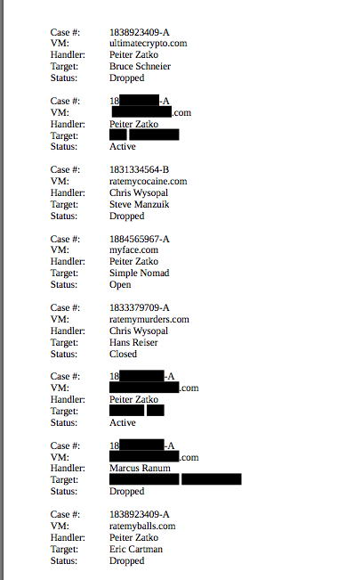
Government Exhibit 5

Slide 16
Stipulations
Factual: an agreement between prosecution and defense on particular facts, eliminating the need for testimony.
Testimonial: an agreement between prosecution and defense that a particular witness would testify in the manner stipulated, if called to the stand.

Slide 17
Government Exhibit 6
DISCLAIMER: The following document is a fictionalized testimonial stipulation for the Black Hat 2003 Conference. The witness of the stipulation does not exist, nor was any evidence in this matter gathered.
IT IS HEREBY STIPULATED AND AGREED between the United States of America,, Assistant United States Attorney, Paul Ohm of counsel, and the defendant Simple Gnomad, by his attorney Jennifer Granick, Esq.:
If called as a witness, Gob Bluth, would testify as follows:
He’s the Policy Enforcement officer at Bluth Industries Internet Access division(bluth.com) which is located in Orange County, California.
bluth.com provides high speed internet access to the Maryland area. Internet access is provided by Digital Subscriber Line (DSL) and Dialup-Connection.
When a subscriber connects to the bluth.com backbone, the subscriber is provided with an Internet Protocol (IP) address that is unique to the subscriber during their session
bluth.com is assigned the Class B address 66.137.0.0 and 63.214.247.170 by the American Registry of Internet Numbers (ARIN) to provide IP addresses for its customers.
UNITED STATES -v- SIMPLE GNOMAD, Defendant
Notes:
Stipulation of Internet provider to IP addresses

Slide 18
Government Exhibit 6 (cont’d)
Mr. Bluth has reviewed the business records maintained by bluth.com for July 1st– August 31st, 2008 and determined that IP address 66.137.228.186 was assigned to the computer owned by L33t Coffee and Tea, 1445 West End Ave, Burbank, CA
Mr. Bluth has reviewed the business records maintained by bluth.com for July 1st – August 31st, 2007 and determined that the above IP address were active during those times.
IT IS FURTHER STIPULATED AND AGREED that this stipulation may be received in evidence as a Government exhibit at trial.
Dated: August 1, 2008
By:____________________________
Paul Ohm
Assistant United States Attorney
By: ___________________________
JENNIFER GRANICK, ESQ.
Attorney forSimple Gnomad
Notes:
Part II of ISP Stipulation

Slide 19
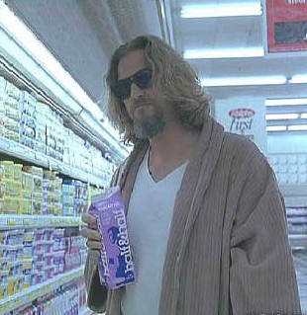
Government Exhibit 7
Notes:
Part II of ISP Stipulation

Slide 20
Prosecution Witness 2
Simon Ross is the journalist who purportedly witnessed the break-in of MyFace. He has been subpoenaed by the prosecution to identify his source.

Slide 21
Evidence Suppression
Defense Argument - Opsahl claims journalist source privilege for the IP address, the fact of the meeting at the coffee shop and what was said and done there.

Slide 22
Evidence Suppression (cont’d)
Prosecution argument - Ohm argues that the source privilege does not apply here because it is a criminal case and because the journalist is a percipient witness to the defendant's presence at the scene of the crime, and possibly also the crime. For the meet, prosecution argues that "the privilege does not extend to personal observations made by the reporter when those observations are made in public places," and that the coffee shop was a public place, citing Kaiyala v. City of Seattle, 1992 U.S. Dist. LEXIS 15461 (W.D. Wash. 1992).

Slide 23
Evidence Suppression (cont’d)
Defense Rebuttal - Opsahl points out that the government must show necessity to get the information, arguing that this Circuit follows Justice Powell's concurrence in Branzburg v. Hayes, 408 U.S. 665 (1972), balancing First Amendment privilege and the government's need for disclosure in light of the surrounding facts and a balance struck to determine where lies the paramount interest.

Slide 24
Evidence Suppression (cont’d)
Under this test, the government must show that it had exhausted other means of obtaining the information and that the information sought went to the heart of an element of the underlying claims. In addition, Opsahl notes that Kaiyala reserved that question of whether the "observations in a public place" rule extends to observations made within the context of an interview, as opposed to a reporter at a public event or on the street, and suggests that it should not be extended.

Slide 25
Evidence Suppression (cont’d)
Prosecution Rebuttal - Ohm rebuts that the information is all necessary for the heart of the claims. The IP information is needed to show that the blog post was made from the same IP as the hack. The details of the meet is necessary to place the defendant at the coffee shop at the time of the hack, and to prove defendant conducted the hack from

Slide 26
Evidence Suppression (cont’d)
For the IP information, out of respect for the Privacy Protection Act, the government did not seize the journalist's computers to obtain the information directly, so the best way was to ask the journalist. For the meet, the government interviewed the coffee shop employees, and no one remembered seeing the meeting. Moreover, there is no other way to find out what was said and done at the meeting.

Slide 27
Judge’s Ruling
Point 1 (IP Address)
  The government has not exhausted its means to get the IP address, such as a subpoena to the journalist's blogging service, so the journalist need not turn that information over.
Point 2 (Coffee shop meeting)
  As for presence at the coffee shop with the defendant and what was said and done there, the journalist is the only way to get that information, so he must testify. Since the First Amendment test is met, no need to decide whether the privilege exists for a coffee shop interview.

Slide 28
Defense Witness 1
Simple Gnomad is the defendant and is not required to take the stand, but has the right to do so if he chooses. His attorney should discourage him from doing so, since the judge can add extra points to his sentence for perjury and obstruction of justice, if he is found guilty.

Slide 29
Defense Exhibit 1
Jul 22 10:49:44 <s-nomad> contacted me
Jul 22 10:49:54 <mudge> yes
Jul 22 10:50:00 <s-nomad> and want me to pwn it?
Jul 22 10:50:11 <s-nomad> a stranger on irc
Jul 22 10:50:29 <s-nomad> you are retarded
Jul 22 10:50:31 <mudge> but it is my site
Jul 22 10:52:35 <s-nomad> yeah right
Jul 22 10:52:52 <mudge> it is, check the whois technical contact e-mail.
Jul 22 10:53:08 <s-nomad> means nothing
Jul 22 10:53:21 <mudge> I am saying go for it
Jul 22 10:53:35 <s-nomad> two questions
Jul 22 10:54:09 <s-nomad> this site have ssl?
Jul 22 10:54:26 <s-nomad> so you can't sniff things
Jul 22 10:54:43 <s-nomad> and are there any limits?
Jul 22 10:54:57 <s-nomad> on pwnage
Jul 22 10:58:32 <mudge> yes there is ssl
Jul 22 10:58:44 <mudge> no limits
Jul 22 10:59:32 <mudge> although I prefer no wiping the drive
Jul 22 11:00:02 <s-nomad> I'd probably be doing the sad fucks on myface a favor if I did that
Jul 22 11:00:03 <mudge> I do have backups
Jul 22 11:00:18 <mudge> so are you?
Jul 22 11:01:11 <s-nomad> well I have to eat first, I am hungry
Jul 22 11:03:34 <mudge> w00t
Jul 22 11:03:45 <s-nomad> half an hour or so?
Jul 22 11:03:53 <mudge> yeah
Jul 22 11:03:56 <mudge> cool
Jul 22 11:04:21 <s-nomad> whatever, expect to be pwned
Jul 22 11:04:46 <mudge> appreciate it
Jul 22 11:05:07 <s-nomad> the sploit needs live testing, you caught me at a lucky moment

Slide 30
Prosecution Closing Statements (C0unt 1)
18 U.S.C. § 1030(a)(5)(A)(ii) - Unauthorized Access and Damage to Computers
The government has accused the defendant of unauthorized access and damage to a protected computer.
To find the defendant guilty of this change, you must find the following elements to be true, based on the evidence and testimony presented:
First, the defendant intentionally accessed a computer without authorization;
Second, as a result of the defendant’s access, the defendant recklessly impaired the integrity or availability of data, a program, a system, or information;
Third, the impairment to the integrity or availability of data, a program, a system, or information resulted in damage affecting a computer system used by or for a government entity in furtherance of the administration of justice, national defense, or national security;
Fourth, the computer damaged was used in interstate or foreign commerce or communication or used exclusively for the use of a financial institution or the United States government.

Slide 31
Prosecution Closing Statements (C0unt 2)
18 U.S.C. § 1030(a)(5)(A)(ii) – Attempted Unauthorized Access and Damage to Computers
The government has also accused the defendant of attempting to commit the same offense, unauthorized access and damage to a protected computer.
In order for the defendant to be found guilty of that charge, the government must prove each of the following elements beyond a reasonable doubt:
First, the defendant intended to commit the crime charged; and
Second, the defendant did something which was a substantial step toward committing the crime, with all of you agreeing as to what constituted the substantial step.
Mere preparation is not a substantial step toward the commission of the crime charged.

Slide 32
Prosecution Closing Statements (C0unt 3)
18 U.S.C. § 1030(a)(2)(B)–Obtaining Information by Computer from Government Computer
First, the defendant intentionally accessed without authorization or exceeded authorized access to a computer; and
Second, by accessing without authorization or exceeding authorized access to a computer, the defendant obtained information from any department or agency of the United States.

Slide 33
Prosecution Closing Statements
18 U.S.C. § 1030(a)(2)(B)–Obtaining Information by Computer from Government Computer
First, the defendant intentionally accessed without authorization or exceeded authorized access to a computer; and
Second, by accessing without authorization or exceeding authorized access to a computer, the defendant obtained information from any department or agency of the United States.

Slide 34
Defense Closing Statements
Simple Gnomad was entrapped.
The real villain is Agent Mudge
He went after my client
He enticed him to use the zero day
He authorized him to hack the system

Slide 35
Entrapment Defense
The government has the burden of proving beyond a reasonable doubt that the defendant was not entrapped. The government must prove the following
First, the defendant was predisposed to commit the crime before being contacted by government agents, or
Second, the defendant was not induced by the government agents to commit the crime.
Where a person, independent of and before government contact, is predisposed to commit the crime, it is not entrapment if government agents merely provide an opportunity to commit the crime.

Slide 36
Panel Discussion

